Slide 1
INSTITUTE OF ENGINEERING & MANAGEMENT, KOLKATA
Course Name : Enzymes

Slide 2
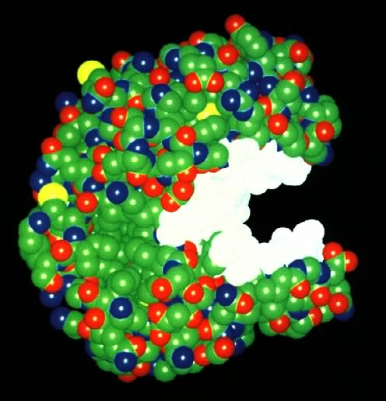
What Are Enzymes?
Most enzymes are Proteins (tertiary and quaternary structures)
Act as Catalyst to accelerates a reaction
Not permanently changed in the process

Slide 3
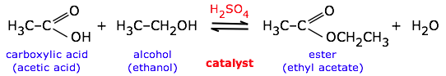
What are Catalysts?
Catalysts have no effect on the equilibrium constant and thus on the equilibrium composition. Catalysts are substances that speed up a reaction but which are not consumed by it and do not appear in the net reaction equation.

Slide 4
Also — and this is very important — catalysts affect the forward and reverse rates equally; this means that catalysts have no effect on the equilibrium constant and thus on the composition of the equilibrium state.
Thus a catalyst (in this case, sulfuric acid) can be used to speed up a reversible reaction such as ester formation or its reverse, ester hydrolysis:

Slide 5
The catalyst has no effect on the equilibrium constant or the direction of the reaction. The direction can be controlled by adding or removing water (Le Chatelier principle).
Catalysts function by allowing the reaction to take place through an alternative mechanism that requires a smaller activation energy.
This change is brought about by a specific interaction between the catalyst and the reaction components.

Slide 6
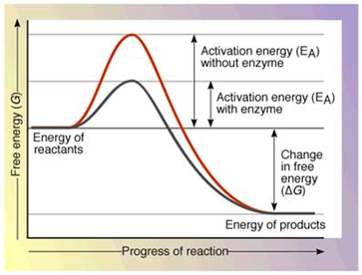

Slide 7
The biological processes that occur within all living organisms are chemical reactions, and most are regulated by enzymes.
Without enzymes, many of these reactions would not take place at a perceptible rate.
Enzymes catalyze all aspects of cell metabolism.

Slide 8
This includes the digestion of food, in which large nutrient molecules (such as proteins, carbohydrates, and fats) are broken down into smaller molecules; the conservation and transformation of chemical energy; and the construction of cellular macromolecules from smaller precursors.
Many inherited human diseases, such as albinism and phenylketonuria, result from a deficiency of a particular enzyme

Slide 9
You may have heard of people who are lactose intolerant, or you may suffer from this problem yourself.
The problem arises because the sugar in milk -- lactose -- does not get broken into its glucose components.
Therefore, it cannot be digested. The intestinal cells of lactose-intolerant people do not produce lactase, the enzyme needed to break down lactose.

Slide 10
This problem shows how the lack of just one enzyme in the human body can lead to problems.
A person who is lactose intolerant can swallow a drop of lactase prior to drinking milk and the problem is solved.
Many enzyme deficiencies are not nearly so easy to fix

Slide 11
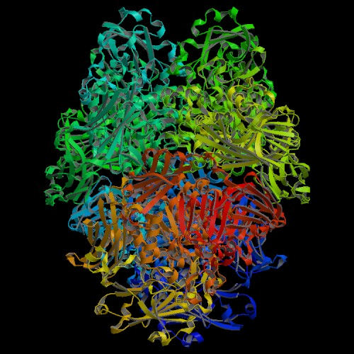

Slide 12
Enzymes are very efficient catalysts for biochemical reactions.
They speed up reactions by providing an alternative reaction pathway of lower activation energy.
Like all catalysts, enzymes take part in the reaction - that is how they provide an alternative reaction pathway.
But they do not undergo permanent changes and so remain unchanged at the end of the reaction.

Slide 13
They can only alter the rate of reaction, not the position of the equilibrium.
Most chemical catalysts catalyse a wide range of reactions. They are not usually very selective.
In contrast enzymes are usually highly selective, catalysing specific reactions only.
This specificity is due to the shapes of the enzyme molecules.

Slide 14
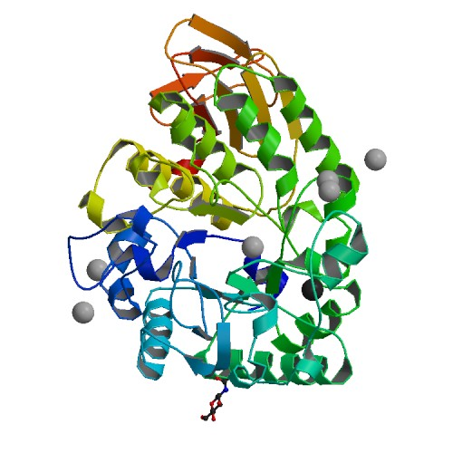
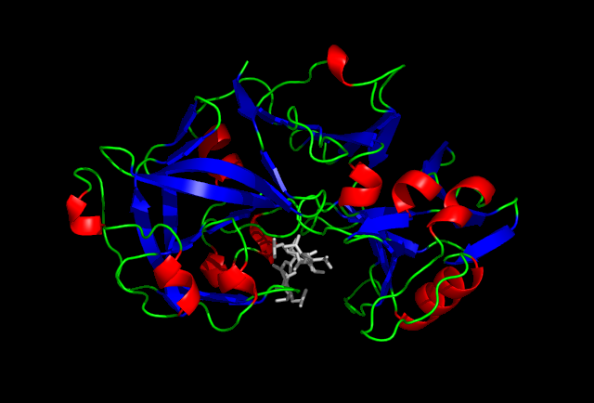
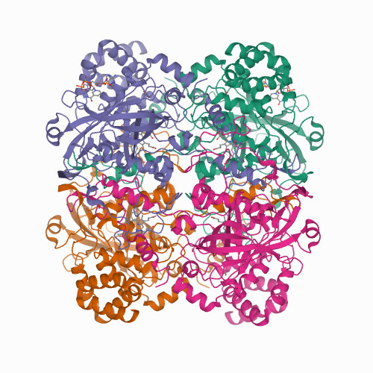

Slide 15
Enzyme synthesis and activity also are influenced by genetic control and distribution in a cell.
Some enzymes are not produced by certain cells, and others are formed only when required.
Enzymes are not always found uniformly within a cell; often they are compartmentalized in the nucleus, on the cellmembrane, or in subcellular structures.
The rates of enzyme synthesis and activity are further influenced by hormones, neurosecretions, and other chemicals that affect the cell’s internal environment.

Slide 16
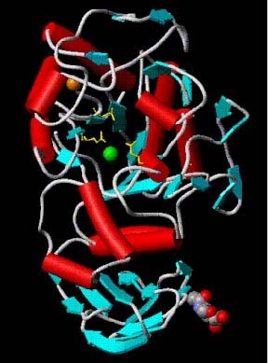
Enzyme structure
Enzymes are proteins
They have a globular shape
A complex 3-D structure
Human pancreatic amylase

Slide 17
Many enzymes consist of a protein and a non-protein (called the cofactor). The proteins in enzymes are usually globular.
The intra- and intermolecular bonds that hold proteins in their secondary and tertiary structures are disrupted by changes in temperature and pH.
This affects shapes and so the catalytic activity of an enzyme is pH and temperature sensitive.

Slide 18
Cofactors may be:
Organic groups that are permanently bound to the enzyme (prosthetic groups)
Cations - positively charged metal ions (activators), which temporarily bind to the active site of the enzyme, giving an intense positive charge to the enzyme's protein
Organic molecules, usually vitamins or made from vitamins (coenzymes), which are not permanently bound to the enzyme molecule, but combine with the enzyme-substrate complex temporarily.

Slide 19
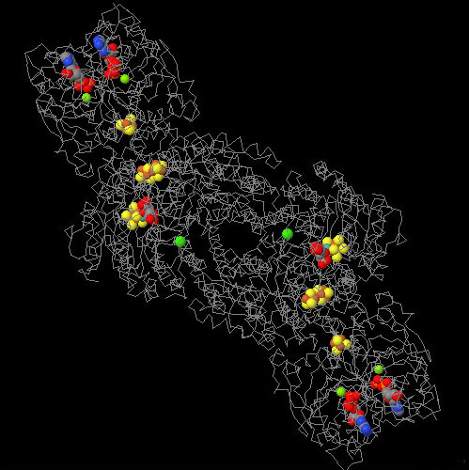
Cofactors
An additional non- protein molecule needed by some enzymes to help the reaction
Tightly bound cofactors are called prosthetic groups
Cofactors that are bound and released easily are called coenzymes
Many vitamins are coenzymes.
Nitrogenase enzyme with Fe, Mo and ADP cofactors

Slide 20
How enzymes work?
For two molecules to react they must collide with one another.
They must collide in the right direction (orientation) and with sufficient energy.
Sufficient energy means that between them they have enough energy to overcome the energy barrier to reaction.
This is called the activation energy.

Slide 21
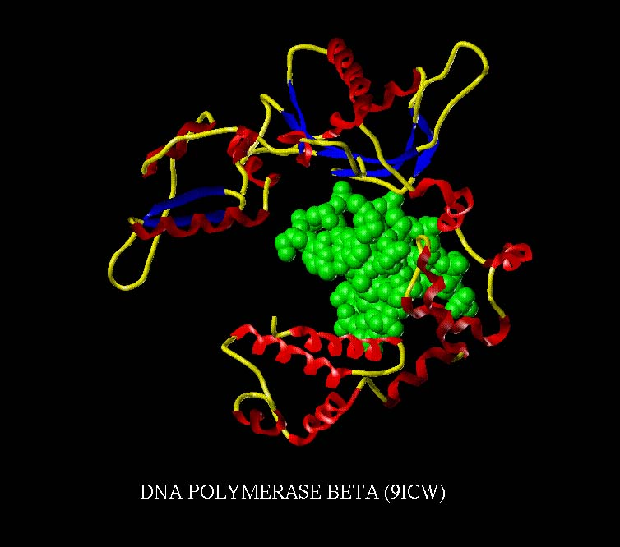
The active site
The shape and the chemical environment inside the active site permits a chemical reaction to proceed more easily.

Slide 22
The substrate
The substrates of enzymes are the reactants that are activated by the enzymes
Enzymes are specific to their substrates
The specificity is determined by the active site.
A simplified picture
Route A reactant 1 + reactant 2 --> product
Route B reactant 1 + enzyme --> intermediate
intermediate + reactant 2 --> product + enzyme
So the enzyme is used to form a reaction intermediate, but when this reacts with another reactant the enzyme reforms.

Slide 23
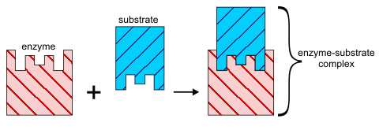
Lock and key hypothesis
This is the simplest model to represent how an enzyme works. The substrate simply fits into the active site to form a reaction intermediate.

Slide 24
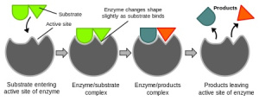
Induced fit hypothesis
In this model the enzyme molecule changes shape as the substrate molecules gets close. The change in shape is 'induced' by the approaching substrate molecule. This more sophisticated model relies on the fact that molecules are flexible because single covalent bonds are free to rotate.

Slide 25
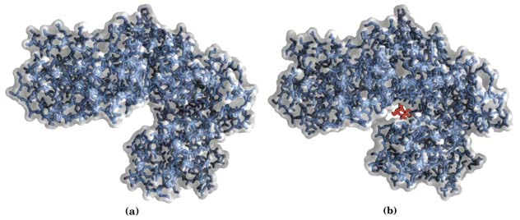
The Induced Fit Hypothesis
Hexokinase (a) without (b) with glucose substrate
This also how some enzymes can react with a range of substrates of similar types.

Slide 26
Factors affecting enzyme activity
substrate concentration
Enzyme concentration
pH
Temperature
Inhibitors
Products of the reactioon
Allosteric effects

Slide 27
Substrate concentration: Non-enzymic reactions
Reaction velocity
Substrate concentration
The increase in velocity is proportional to the substrate concentration.

Slide 28
Substrate concentration: Enzymic reactions
V_{max}
Reaction velocity
Substrate concentration
Faster reaction but it reaches a saturation point when all the enzyme molecules are occupied
Alter the concentration of the enzyme then V_{max} will change too.

Slide 29
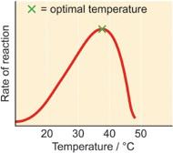
Factors affecting catalytic activity of enzymes:
Temperature

Slide 30
As the temperature rises, reacting molecules have more and more kinetic energy.
This increases the chances of a successful collision and so the rate increases.
There is a certain temperature at which an enzyme's catalytic activity is at its greatest .

Slide 31
This optimal temperature is usually around human body temperature (37.5 ºC) for the enzymes in human cells.
Above this temperature the enzyme structure begins to break down (denature) since at higher temperatures intra- and intermolecular bonds are broken as the enzyme molecules gain even more kinetic energy.

Slide 32
The effect of temperature
Q₁₀ (the temperature coefficient) = the increase in reaction rate with a 10°C rise in temperature
For chemical reactions the Q₁₀ = 2 to 3
Enzyme-controlled reactions follow this rule as they are chemical reactions
BUT at high temperatures proteins denature
The optimum temperature for an enzyme controlled reaction will be a balance between the Q₁₀ and denaturation.

Slide 33
For most enzymes the optimum temperature is about 30°C
Many are a lot lower, cold water fish will die at 30°C because their enzymes denature
A few bacteria have enzymes that can withstand very high temperatures up to 100°C
Most enzymes however are fully denatured at 70°C.

Slide 34
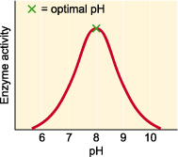
pH
Effect of pH
Each enzyme works within quite a small pH range.
There is a pH at which its activity is greatest (the optimal pH).
This is because changes in pH can make and break intra- and intermolecular bonds, changing the shape of the enzyme and, therefore, its effectiveness.

Slide 35
The effect of pH
Extreme pH levels will produce denaturation
The structure of the enzyme is changed
The active site is distorted and the substrate molecules will no longer fit in it
At pH values slightly different from the enzyme’s optimum value, small changes in the charges on the enzyme and it’s substrate molecules will occur
This change will affect the binding of the substrate with the active site.

Slide 36
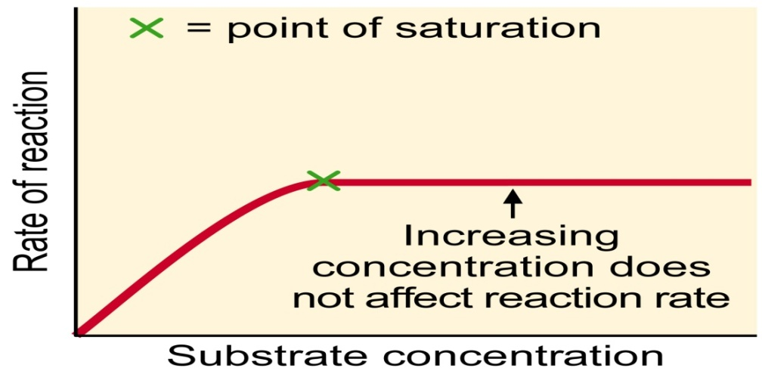
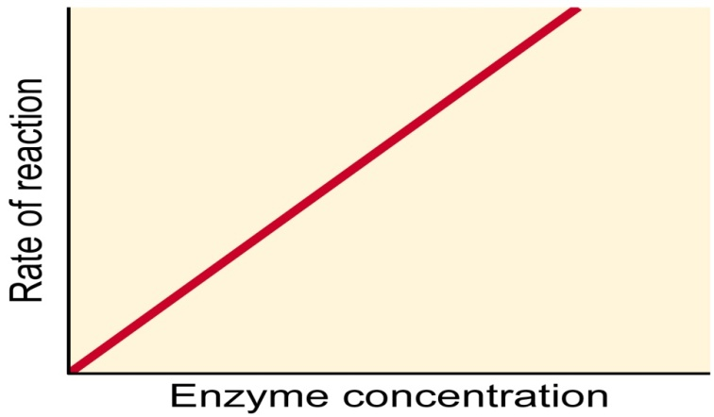
Concentration of enzyme and substrate
For a given enzyme concentration, the rate of reaction increases with increasing substrate concentration up to a point, above which any further increase in substrate concentration produces no significant change in reaction rate.

Slide 37
This is because the active sites of the enzyme molecules at any given moment are virtually saturated with substrate.
The enzyme/substrate complex has to dissociate before the active sites are free to accommodate more substrate.
Provided that the substrate concentration is high and that temperature and pH are kept constant, the rate of reaction is proportional to the enzyme concentration. (See graph)

Slide 38
Enzyme synthesis and activity also are influenced by genetic control and distribution in a cell.
Some enzymes are not produced by certain cells, and others are formed only when required.
Enzymes are not always found uniformly within a cell; often they are compartmentalized in the nucleus, on the cell membrane, or in subcellular structures.
The rates of enzyme synthesis and activity are further influenced by hormones, neurosecretions, and other chemicals that affect the cell’s internal environment.

Slide 39
Enzymes are generally named according to the reaction they catalyze or by suffixing “ase” after the name of substrate.
The International Union of Biochemistry and Molecular Biology developed a nomenclature for enzymes.
Each enzyme is described by a sequence of four numbers preceded by "EC". EC denotes Enzyme Commission and the number of enzyme is called EC numbers.

Slide 40
When classified, each enzyme is assigned the EC number, in the form of digits separated by periods.
The first number categorizes the enzyme based on its reaction.
The first three numbers represent the class, subclass and sub-subclass to which an enzyme belongs, and the fourth digit is a serial number to identify the particular enzyme within a sub-subclass.

Slide 41
The class, subclass and sub-subclass provide additional information about the reaction classified.
For example, in the case of EC 1.2.3.4, the digits indicate that the enzyme is an oxidoreductase (class 1),that it acts on the aldehyde or oxo group of donors (subclass 2), that oxygen is an acceptor (sub-subclass 3) and that it was the fourth enzyme classified in this sub-subclass (serial number 4).
The last printed list of enzymes appeared in the year 1992.
Since then it has been updated and maintained online.

Slide 42
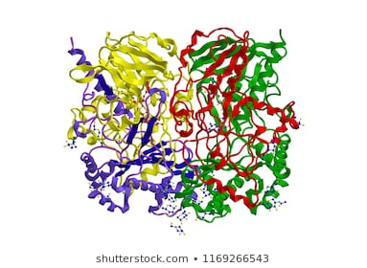
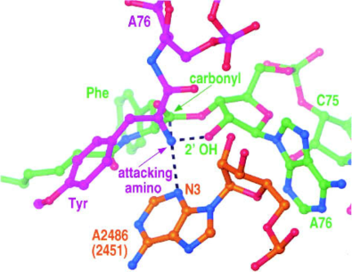
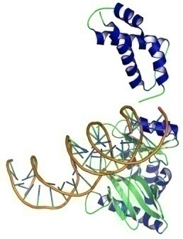
Enzyme classification
1.Enzymes are divided into six major classes with several subclasses.
Oxidoreductases are involved in oxidation and
reduction. Eg. glucose oxidase
Transferases transfer functional groups (e.g., amino
or phosphate groups). Eg. peptidyl transferase
Ligases join two molecules. Eg. T4 RNA ligase 1

Slide 43
Hydrolases transfer water; that is, they catalyze the hydrolysis of a substrate.
Lyases add (or remove) the elements of water, ammonia, or
carbon dioxide (CO2)to (or from) double bonds.
Isomerases catalyze rearrangements of atoms within a
molecule.

Slide 44
Six Major Classes of Enzymes and Examples of Their Subclasses
Classification Distinguishing Feature
1. Oxidoreductases Аred +Вox →Аоx + Вred
Oxidases Use oxygen as an electron acceptor but
do not incorporate it into the substrate
Dehydrogenases Use molecules other than oxygen (e.g.,
NAD+) as an elec-tron acceptor

Slide 45
2.Hydrolases А-В+Н2О→А-Н + В-ОН
Oxygenases Directly incorporate oxygen into the substrate Peroxidases Use H₂O₂ as an electron acceptor
3. Transferases А-В+С→А+В-С
Methyltransferases Transfer one-carbon units between substrates Aminotransferases Transfer NH2 from amino acids to keto
acids

Slide 46
4. Kinases Transfer PO3~ from ATP to a substrate
Phosphorylases Transfer PO3~ from inorganic
phosphate (P,) to a substrate
5.Phosphatases Remove PO3~ from a substrate Phosphodiesterases Cleave phosphodiester bonds such as
those in nucleic acids
6. Proteases Cleave amide bonds such as those in
proteins

Slide 47
The Michaelis-Menten Model Accounts for the Kinetic Properties of Many Enzymes
The primary function of enzymes is to enhance rates of reactions so that they are compatible with the needs of the organism.
To understand how enzymes function, we need a kinetic description of their activity.
For many enzymes, the rate of catalysis V₀, which is defined as the number of moles of product formed per second, varies with the substrate concentration [S] .

Slide 48
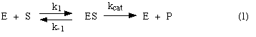
The rate of catalysis rises linearly as substrate concentration increases and then begins to level off and approach a maximum at higher substrate concentrations.
Before we can accurately interpret this graph, we need to understand how it is generated.
Consider an enzyme that catalyzes the S to P by the following pathway:

Slide 49
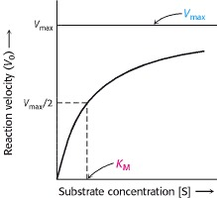
Michaelis-Menten Kinetics
A plot of the reaction velocity (V₀) as a function of the substrate concentration [S] for an enzyme that obeys Michaelis-Menten kinetics shows that the maximal velocity (V_{max}) is approached asymptotically. The Michaelis constant (K_{M}) is the substrate concentration yielding a velocity of V_{max}/2.

Slide 50
In this model, the substrate S reversibly associates with the enzyme E in a first step, and some of the resulting complex ES is allowed to break down and yield the product P and the free enzyme back.
We would like to know how to recognize an enzyme that behaves according to this model.
One way is to look at the enzyme's kinetic behavior -- at how substrate concentration affects its rate.

Slide 51
So we want to know what rate law such an enzyme would obey. If a newly discovered enzyme obeys that rate law, then we can assume that it acts according to this model.
Let's derive a rate law from this model.
For this model, let v₀ be the initial velocity of the reaction.
The latter stands for the appearance of the product P in solution (+ d[P]/dt) whose phenomenological rate equation (first-order) is given b
v₀ = k_{cat}[ES] (2)
containing an experimentally measurable (dependent) variable - v₀, a kinetic parameter - k_{cat}, and another variable unknown to us - [ES].

Slide 52
Before proceeding, one should state (and remember) some implicite assumptions:
As long as initial velocity is considered, the concentration of product can be neglected (compared to that of the substrate, thus [P] << [S]), and
The concentration of substrate is in large excess over that of the enzyme ([E] << [S]).
These assumptions, which hold in most kinetic experiments performed in test tubes at low enzyme concentration, are convenient when considering the mass conservation equations for the reactants
[S]₀ = [S]_{free} + [ES] + [P] which now approximates to [S]₀ = [S],
while that for the enzyme is
[E]_{total} = [E]_{free} + [ES] (the possible formation of a complex EP is not considered here).

Slide 53
We want to express v₀ in terms of measurable (experimentally defined, independent) variables, like [S] and [E]_{total} , so we can see how to test the mechanism by experiments in kinetics.
So we must replace the unknown [ES] in (2) with measurables.
During the initial phase of the reaction, as long as the reaction velocity remains constant, the reaction is in a steady state, with ES being formed and consumed at the same rate.
During this phase, the rate of formation of [ES] (one second order kinetic step) equals its rate of consumption (two first order kinetic steps).

Slide 54
According to model (1),
Rate of formation of [ES] = k₁[E][S].
Rate of consumption of [ES] = k₋₁[ES] + k_{cat} [ES].
So in the steady state,
k₋₁[ES] + k_{cat}[ES] = k₁[E][S] (3)
Remember that we are trying to solve for [ES] in terms of measurables, so that we can replace it in (2).
First, collect the kinetic constants, and the concentrations (variables) in (3):
(k₋₁ + k_{cat}) [ES] = k₁ [E][S],and (4)
(k₋₁ + k_{cat})/k₁ = [E][S]/[ES]

Slide 55
To simplify (4), first group the kinetic constants by defining them as K_{m}:
K_{m} = (k₋₁ + k_{cat})/k₁ (5)
and then express [E] in terms of [ES] and [E]_{total}, to limit the number of unknowns:
[E] = [E]_{total} - [ES] (6)
Substitute (5) and (6) into (4):
K_{m} = ([E]_{total} - [ES]) [S]/[ES] (7)

Slide 56
Solve (7) for [ES]:
First multiply both sides by [ES]
[ES] K_{m} = [E]_{total}[S] - [ES][S]
Then collect terms containing [ES] on the left:
[ES] K_{m} + [ES][S] = [E]_{total}[S]
Factor [ES] from the left-hand terms:
[ES](K_{m} + [S]) = [E]_{total}[S]
and finally, divide both sides by (K_{m} + [S]):
[ES] = [E]_{total} [S]/(K_{m} + [S]) (8)

Slide 57
Substitute (8) into (2):
v₀ = k_{cat}[E]_{total} [S]/(K_{m} + [S]) (9)
The maximum velocity V_{max} occurs when the enzyme is saturated -- that is, when all enzyme molecules are tied up with S, or [ES] = [E]_{total}.
Thus,
V_{max} = k_{cat} [E]_{total} (10)
Substitute V_{max} into (9) for k_{cat} [E]_{total}:
v₀ = V_{max} [S]/(K_{m} + [S]) (11)

Slide 58
This equation expresses the initial rate of reaction in terms of a measurable quantity, the initial substrate concentration.
The two kinetic parameters, V_{max} and K_{m} , will be different for every enzyme-substrate pair.
This is the equation of a rectangular hyperbola, just like the saturation equation for the binding of oxygen to myoglobin.

Slide 59
Further analysis reveals the physical meaning of K_{m}: the concentration of substrate at which the velocity is half V_{max}. Indeed, substituting K_{m} for [S] in (11) yields
v₀ = 1/2 V_{max}.
Thus, a low value for K_{m} may indicate a high affinity of the enzyme for its substrate.
In this case, the velocity becomes proportional to the (low, relative to K_{m}) substrate concentration, displaying pseudo-first order kinetics in [S].

Slide 60
The parameter V_{max} /K_{m} (or rather its constant part k_{cat} /K_{m}), often referred to as the catalytic ability of the enzyme, is a direct measure of the efficiency of the enzyme in transforming the substrate S.
k_{cat} /K_{m} recombines the two traditionally-separated aspects of enzyme catalysis:
the effectiveness of transformation of bound product (catalysis per se, k_{cat} )
* the effectiveness of productive substrate binding (affinity, 1/K_{m} = k₁ /(k₋₁ + k_{cat}))

Slide 61
Lineweaver-Burk (double reciprocal) plot
A linear representation is more accurate and convinient for determining V_{max} and K_{m}.
This equation is obtained by taking reciprocal of both the side of Michelis-Menton equation.
1/[S] vs. 1/V_{o}

Slide 62
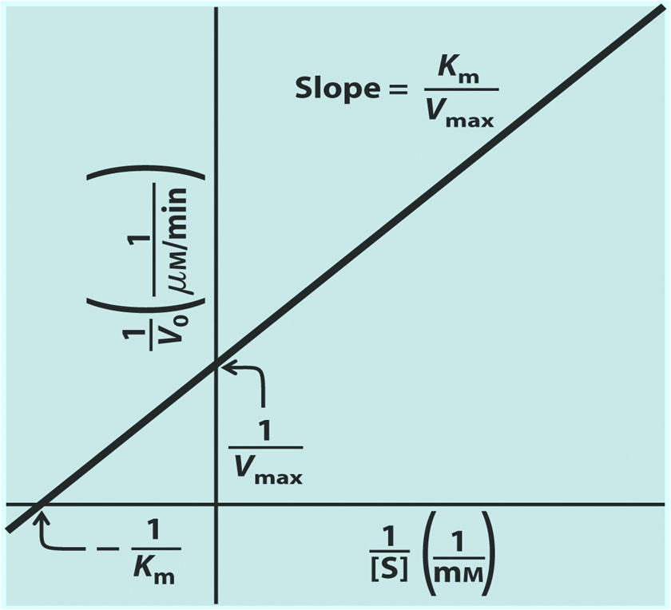
Lineweaver-Burk (Double Reciprocal) Plot

Slide 63
Allosteric Enzymes Do Not Obey Michaelis-Menten Kinetics
The Michaelis-Menten model has greatly assisted the development of enzyme chemistry.
Its virtues are simplicity and broad applicability.
However, the Michaelis-Menten model cannot account for the kinetic properties of many enzymes.
An important group of enzymes that do not obey Michaelis-Menten kinetics comprises the allosteric enzymes.

Slide 64
These enzymes consist of multiple subunits and multiple active sites.
Allosteric enzymes often display sigmoidal plots of the reaction velocity V₀ versus substrate concentration [S], rather than the hyperbolic plots predicted by the Michaelis-Menten equation.
Prominent examples of allosteric enzymes in metabolic pathways are
glycogen phosphorylase ,
phosphofructokinase ,
glutamine synthetase , and
aspartate transcarbamoylase (ATCase).

Slide 65
In allosteric enzymes, the binding of substrate to one active site can affect the properties of other active sites in the same enzyme molecule.
A possible outcome of this interaction between subunits is that the binding of substrate becomes cooperative; that is, the binding of substrate to one active site of the enzyme facilitates substrate binding to the other active sites.

Slide 66
Reversible inhibitors can be classified into :
Competitive
Non-competitive
Un-competitive

Slide 67
Enzyme Inhibition
Competitive Inhibition
Probably the easiest type of enzyme inhibition to understand is competitive inhibition and it is the one most commonly exploited pharmaceutically.
Molecules that are competitive inhibitors of enzymes resemble one of the normal substrates of an enzyme.
An example is methotrexate, which resembles the folate substrate of the enzyme dihydrofolate reductase (DHFR).

Slide 68
This enzyme normally catalyzes the reduction of folate, an important reaction in the metabolism of nucleotides.
When the drug methotrexate is present, some of the enzyme binds to it instead of to folate and during the time methotrexate is bound, the enzyme is inactive and unable to bind folate.
Thus, the enzyme is inhibited.
.

Slide 69
Notably, the binding site on DHFR for methotrexate is the active site, the same place that folate would normally bind.
As a result, methotrexate ‘competes’ with folate for binding to the enzyme. The more methotrexate there is, the more effectively it competes with folate for the enzyme’s active site. Conversely, the more folate there is, the less of an effect methotrexate has on the enzyme because folate outcompetes it.

Slide 70
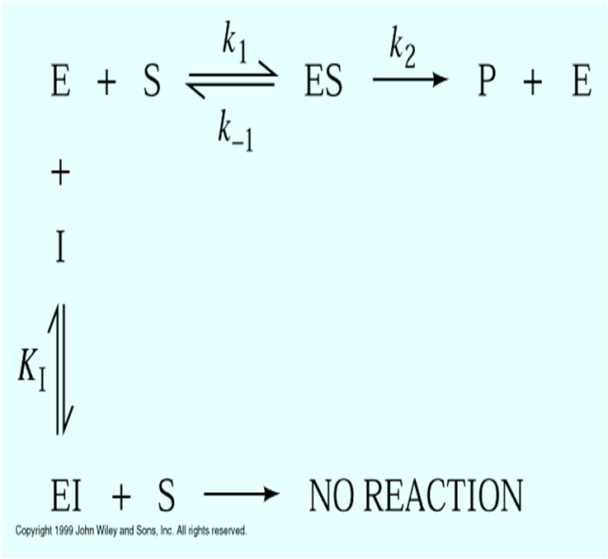
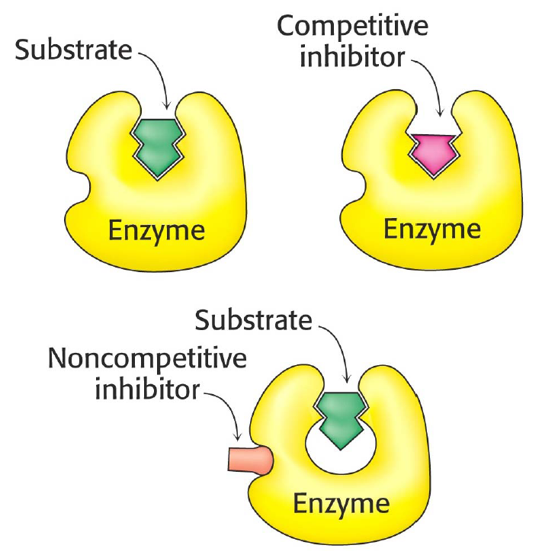
Competitive Inhibition

Slide 71
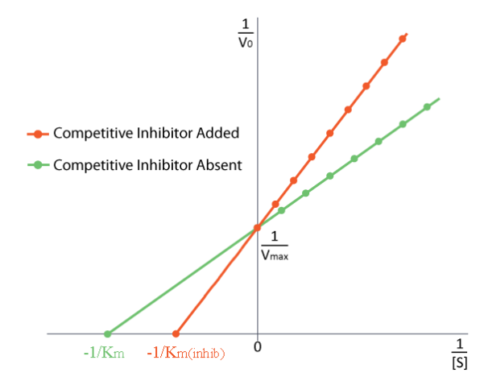
Molecule with similar structure to substrate
Competes for active site bonding
Blocks active site temporarily
Enzyme activity reduced / stopped
Reversible reaction
(weak interactions: H bonding, etc)
Increasing concentration of substrate
can overcome
inhibition effect (out competes for
active site)

Slide 72
Non-Competitive Inhibition
A second type of inhibition employs inhibitors that do not resemble the substrate and bind not to the active site, but rather to a separate site on the enzyme (rectangular site below).
The effect of binding a non-competitive inhibitor is significantly different from binding a competitive inhibitor because there is no competition.

Slide 73
In the case of competitive inhibition, the effect of the inhibitor could be reduced and eventually overwhelmed with increasing amounts of substrate.
This was because increasing substrate made increasing percentages of the enzyme active.
With non-competitive inhibition, increasing the amount of substrate has no effect on the percentage of enzyme that is active.
Indeed, in non-competitive inhibition, the percentage of enzyme inhibited remains the same through all ranges of [S].

Slide 74
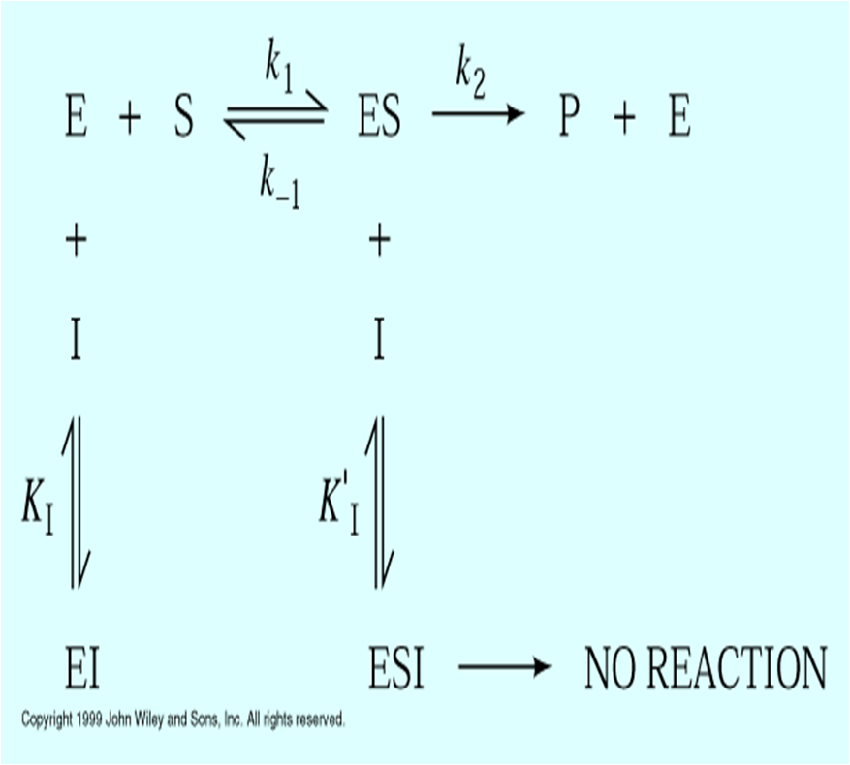
Non-Competitive Inhibition

Slide 75
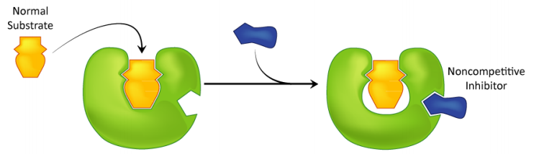
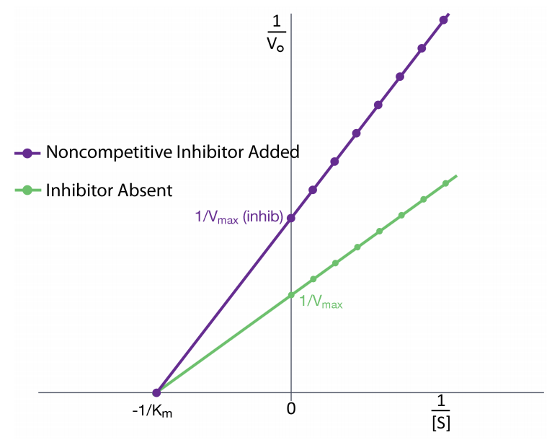
Bonds to another site other than active site
Tertiary structure of enzyme altered
Affects shape of active site (conformation change)
Lowers or blocks substrate affinity for active site
Reversible
Increasing concentration of substrate does not overcome inhibition effect

Slide 76
Uncompetitive Inhibition
A third type of enzymatic inhibition is that of uncompetitive inhibition, which has the odd property of a reduced Vmax as well as a reduced K_{M}.
The explanation for these seemingly odd results is rooted in the fact that the uncompetitive inhibitor binds only to the enzyme-substrate (ES) complex.
The inhibitor-bound complex forms mostly under concentrations of high substrate and the ES-I complex cannot release product while the inhibitor is bound, thus explaining the reduced Vmax.

Slide 77
The reduced K_{M} is a bit harder to conceptualize.
The answer lies in the fact that the inhibitor-bound complex effectively reduces the concentration of the ES complex.
By Le Chatelier’s Principle, a shift occurs to form additional ES complex, resulting in less free enzyme and more enzyme in the forms ES and ESI (ES with inhibitor).
Decreases in free enzyme correspond to an enzyme with greater affinity for its substrate.
Thus, paradoxically, uncompetitive inhibition both decreases Vmax and increases an enzyme’s affinity for its substrate

Slide 78
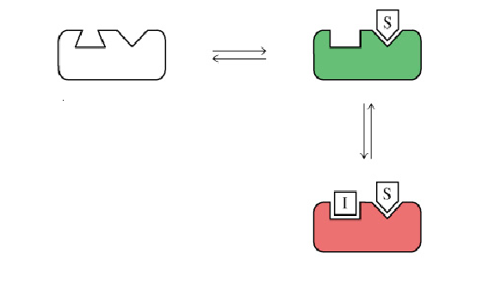
Un-competitive Inhibiton
ES Complex
Enzyme
+ Inhibitor
ESI complex

Slide 79
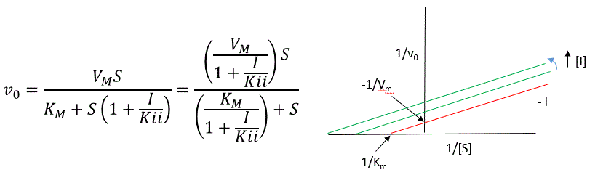
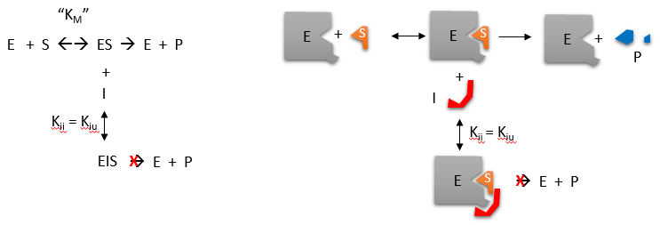

Slide 80
V_{max}
V_{max}
V_{max}
v_{o}
v_{o}
V_{max}’
V_{max}’
I
I
I
Direct Plots
K_{m}
K_{m}’
[S], mM
K_{m}
= K_{m}’
[S], mM
K_{m}’
K_{m}
[S], mM
V_{max} unchanged
K_{m} increased
V_{max} decreased
K_{m} unchanged
Both V_{max} & K_{m} decreased
1/v_{o}
I
1/v_{o}
I
1/v_{o}
I
Double Reciprocal
Intersect
at X axis
Two parallel
lines
Intersect
at Y axis
1/ V_{max}
1/ V_{max}
1/ V_{max}
1/K_{m}
1/[S]
1/K_{m}
1/[S]
1/K_{m}
1/[S]
Competitive
Non-competitive
Uncompetitive

Slide 81
Allosteric Enzymes
What is a Allosteric Enzyme?
An allosteric enzyme is an enzyme that contains a region to which small, regulatory molecules ("effectors") may bind in addition to and separate from the substrate binding site and thereby affect the catalytic activity.
On binding the effector, the catalytic activity of the enzyme towards the substrate may be enhanced, in which case the effector is an activator, or reduced, in which case it is a de-activator or inhibitor.

Slide 82
Allosteric enzymes are enzymes which have an additional site, as well as the active site – it comes from the Greek ‘allo’, which means ‘other’.
These are called allosteric sites, and enzymes can have more than one.
They are unique in that they have the ability to respond to multiple different conditions in their immediate environment.
Also, when allosteric enzymes are shown on a graph as velocity against substrate concentration, they show a sigmoid curve rather than the usual hyperparabolic curve.

Slide 83
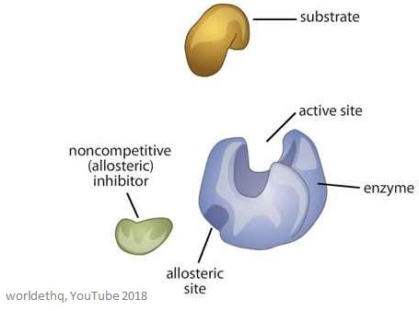
Properties of Allosteric Enzymes:
Allosteric or Regulatory enzymes have multiple subunits (Quaternary Structure) and multiple active sites.
Allosteric enzymes have active and inactive shapes differing in 3D structure.

Slide 84
Allosteric enzymes often have multiple inhibitor or activator binding sites involved in switching between active and inactive shapes
Allosteric sites are binding sites on the enzyme – they are different from the active site and the substrate binding site
The molecule that binds to the allosteric site is called an effector (it can also be called a modulator), and it regulates the activity of the enzyme it binds to.

Slide 85
The activity of the enzyme is increased when a positive allosteric effector binds to the allosteric site.
This means that the activity of the enzyme is decreased when a negative allosteric effector binds to the allosteric site – they inhibit the enzyme
Allosteric enzymes are larger and more complex than non-allosteric enzymes and often have many sub-units.
Enzymes with more than one effector have different and specific binding sites for each one.

Slide 86
In most allosteric enzymes, the substrate binding site and the effector binding site are on different subunits.
The substrate binding site is on the catalytic subunit – often referred to as the C subunit.
The effector binding site is on the regulatory subunit – often referred to as the R subunit.
When an effector molecule at one binding site causes a conformational change in that subunit, a conformational change is then caused in the other subunits in the protein – this means that a huge portion of the binding energy of the effector is used to change the conformation of the whole protein complex.

Slide 87
This interaction between all of the subunits can be expressed using the Hill coefficient – this is also called a cooperativity coefficient.
When n=1, there will be no interaction between the subunits in the enzyme.
The larger the Hill coefficient (cooperativity coefficient), the stronger the interactions between all of the subunits in the enzyme.
Allosteric enzymes can also ‘switch’ between their active form and their inactive form.

Slide 88
This allows for sophisticated response patterns in activity, which can play a huge role in biological function.
Once the effector dissociates from the binding site, the enzyme is then able to revert back to its inactive (or less active) form.
They can control the rates of highly important reactions, such as ATP production.
When an effector binds to an enzyme, it is called cooperative binding

Slide 89
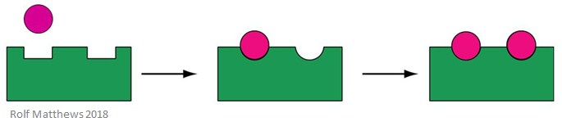
Homotropic Regulation
A homotropic allosteric effector is a substrate for the enzyme, as well as a regulatory molecule – the prefix ‘homo’ refers to them being the same.
They are usually activators of the enzyme. The below image shows a homotropic allosteric effector.
A good example of a homotropic allosteric effector is oxygen (O₂) – it acts as an effector of haemoglobin in the human body.

Slide 90
OR
A modulator is a me­tabolite, when bound to the allosteric site of an enzyme, alters its kinetic characteristics.
The modulators for allosteric enzyme may be ei­ther stimulatory or inhibitory. A stimulator is often the sub­strate itself.
The regulatory enzymes for which substrate and modulator are identical are called homo-tropic.

Slide 91
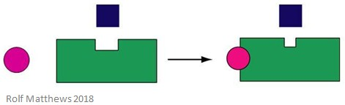
Heterotropic Regulation
A heterotropic allosteric effector is a regulatory molecule which is not also the substrate for the enzyme.
It can either activate or inhibit the enzyme it binds to.
The below image shows a heterotropic allosteric effector.
A good example of a heterotropic allosteric effector is carbon dioxide (CO₂) – it also acts as an effector of haemoglobin but is not the enzyme’s substrate.

Slide 92
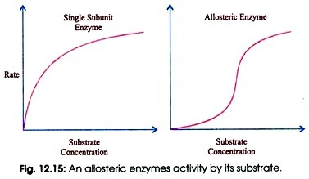
When the modulator has a structure different then the substrate, the enzyme is called heterotropic.
Some enzymes have more then one modulators.
The allosteric enzymes also have one or more regulatory or aliosteric sites for binding the modulator.
Enzymes with several modulators generally have different specific binding sites for each

Slide 93
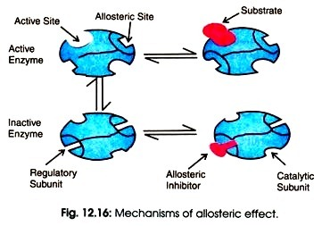
The sigmoid curve is given by homo-tropic enzymes in which the substrate also serve as a positive (stimulator) modulator .
Curve for the non-regulatory enzymes is hyperbolic, as also predicted by the Michaelis-Menten equation, whereas allosteric en­zymes do not show Michaelis- Menten relationship because their kinetic behaviour is greatly altered by variation in the concentration of modulators.

Slide 94
Essential Activators
Essential activators are allosteric activators that, without which, the enzyme activity would be so low it would be negligible.
For example, N-acetylglutamate is an essential activator for carbamoyl phosphate synthetase I.
They are the exact opposite of enzyme inhibitors.

Slide 95
Mechanism of Action of Allosteric Enzymes:
Two general models for the inter-conversion of inactive and active forms of allosteric enzymes have been proposed:
Simple sequential model:
This model was proposed by Koshland Jr. in the year 1966. According to this theory, the aliosteric enzyme can exist in only two conformational changes individually.

Slide 96
Consider an aliosteric enzyme consisting of two identical subunits, each containing an active site
The T (tense) form has low affinity and the R (relaxed) form has high affinity for substrate.
In this model, the binding of substrate to one of the subunits induces a T → R transition in that subunit but not in the other subunits.

Slide 97
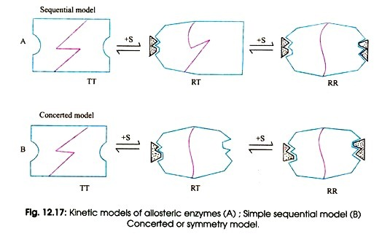

Slide 98
Concerted or Symmetry Model:
This model was proposed by Jacques Monod and his colleagues in 1965.
According to them, an allosteric enzyme can exist in still two conformations, active and relaxed or inactive form.
All subunits are either in the active form or all are in inactive form.

Slide 99
Every substrate molecule that binds with enzyme increases the probability of transition from the inactive to the active site.
The effect of allosteric activators and inhibitors can be explained quite easily by this model.
An allosteric inhibitor binds preferably to the T form whereas an allosteric activator binds to the R form. An allosteric inhibitor shifts The R → T conformational equilibrium towards T. Whereas an allosteric activator shifts it toward R

Slide 100
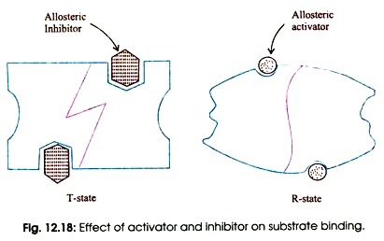
The result is that an allosteric activator increases the binding to substrate of the enzyme, whereas an allosteric inhibitor decreases substrate binding .
Symmetry is conserved in this model but not in the sequential model.

Slide 101
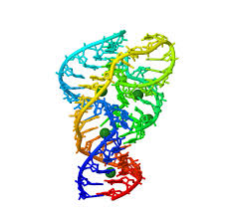
Ribozymes
RNA molecules that act as enzymes are called ribozymes. This property of some RNA's was discovered by Sidney Altman and Thomas Czech, who were awarded the Nobel Prize in Chemistry in 1989.
In contrast to protein enzymes which are true catalysts in that they are used over again, this is an example of a single use ribozyme.
.

Slide 102
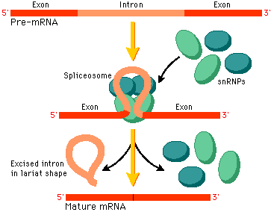
Other ribozymes are true catalysts and can carry out RNA slicing by transesterification (splicesome) and peptidyl transfer (in ribosomes).
The mechanisms of catalysis of the hepatitis delta virus ribozyme include general acid/base catalysis
Ribozymes are RNA molecules that accelerate chemical reactions, enzymes that happen to be made of RNA rather than protein.

Slide 103
Two of the cell's most important reactions are catalyzed by RNA.
The condensation of amino acids in the peptidyl transferase center of the ribosome (arguably THE most important reaction in the cell!) is catalyzed not by protein, but by the major RNA component of the large subunit.
Similarly, the splicing of mRNA in eukaryotes is catalyzed by the U2-U6 snRNA.
So mechanistically both the ribosome and the spliceosome are ribozymes.

Slide 104
Until recently, protein enzymes were thought to be the only biologically active catalysts.
It was believed that DNA stored the genetic information and that RNA played the role of an intermediate courier between the genetic messages contained in the DNA and the ribosomes, where proteins are synthesized.
Other RNAs, like transfer RNAs (tRNAs) and ribosomal RNAs (rRNAs), were considered as helper molecules to assist the function of proteins.

Slide 105
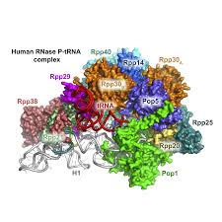
Catalytic RNAs, or ribozymes, are found widely in nature and therefore have a nondispensable biological activity.
In the tRNA-processing enzyme ribonuclease P (RNase P), the RNA moiety contains the catalytic activity.
Self-splicing introns often occur within ribosomal genes, as in the rRNA of Tetrahymena thermophila.
The human hepatitis delta virus RNA and some plant virus RNAs, like the tobacco ringspot virus satellite RNAs, require RNA self-cleavage and ligation for replication

Slide 106
Ribozymes need to acquire three-dimensional architectures to promote specific interactions with cofactors, especially divalent metal ions, and other functional domains for processing RNA substrates.
Ribozymes are generally built up of several structural subdomains made of helical segments connected by tertiary contacts.
Functional regions are usually located in single-stranded regions, such as internal loops or bulges.

Slide 107
Specific tertiary contacts occur between hairpin and internal loops, especially those positioned on the outside of the molecule.
The subdomains have various functions and are responsible for substrate recognition, specific sequence alignment and catalytic activity, leading to a modular and hierarchically organized architecture

Slide 108
Some ribozymes, like the hammerhead ribozyme, the hairpin ribozyme and the RNAase P RNA, are under extensive clinical research for their ability to cleave other specifically chosen substrate RNAs.
The therapeutic applications range from
cleavage of viral RNAs,
like the acquired immune deficiency syndrome (AIDS)-causing human immunodeficiency virus (HIV) RNA,
to silencing of carcinogenic or mutated cellular RNAs, or the control of gene expression in vivo

Slide 109
Sequence and Structure RNA molecules are built up of RNA helices interlinked by internal loops and multiple junctions.
Double-stranded helical regions are formed through standard Watson– Crick base pairs.
One groove of the standard type A-form double-stranded RNA helix is deep and narrow, while the other one is shallow and wide.

Slide 110
Double-stranded regions mainly act as a framework or rigid spacer to organize and to orientate other structural and functional recognition elements.
Helices can be connected by three-, four-or multiway junctions, which form a sequence-dependent joint, which is either flexible or fixed, depending, among other factors, on the type and concentration of metal ions

Slide 111
Single-stranded regions comprise a whole range of structural elements, including base bulges, internal loops or bubbles and terminal or hairpin loops.
These can simply serve as flexible linkers between helical domains, or they interact with other bases, usually forming non-Watson– Crick pairs to widen or tighten the grooves or to induce kinks and bends in the RNA backbone.
These regions also form tertiary interactions with other regions of the same or other RNA oligonucleotides forming pseudoknots, kissing loops or multistranded helices.

Slide 112
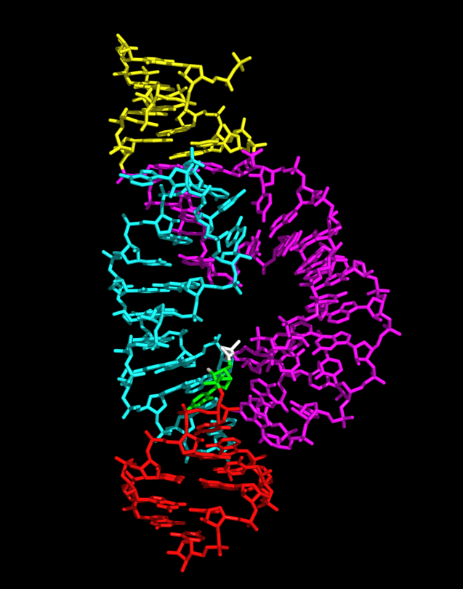
How does RNA catalyze reactions?
It may seem remarkable that a nucleic acid can function as an enzyme. Its components occupy a small fraction of the chemical space of a protein.
Yet ribozymes can accelerate reactions a million fold or more, providing a challenge to the mechanistic chemist to explain how this is possible.

Slide 113
With the exception of peptidyl transferase, all known natural ribozymes catalyze phosphoryl transfer reactions, either transesterification or hydrolysis of phosphate esters.
Protein enzymes have evolved two solutions to the catalysis of phosphoryl transfer, and the ribozymes exhibit a similar divergence of strategy.

Slide 114
The observed rates of cleavage of the nucleolytic ribozymes are typically of the order 1–10 per minute.
Given that these are self-cleaving ribozymes this is probably as fast as they require, but compared to protein nucleases it is very slow.
A significant limitation is imposed by the pK_{a} values of the nucleobases which, in contrast to histidine, can be relatively far from neutrality.

Slide 115
For example, the VS ribozyme uses the combination of nucleobases of relatively low (adenine) and high (guanine) pK_{a} so that only a few ribozyme molecules in 10,000 are in the required state of protonation at a given moment.
If we correct for this we find that the intrinsic rate of cleavage by active ribozyme molecules is comparable with that for RNase A

Slide 116

Thank You

